Slide 1
Query by Humming Searching
Jiarui Xu(Jerry), Alexander Lerch

Slide 2
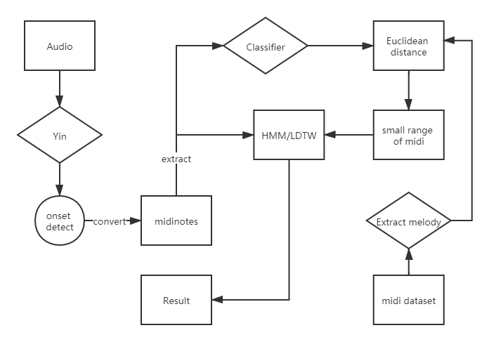
Baseline

Slide 3
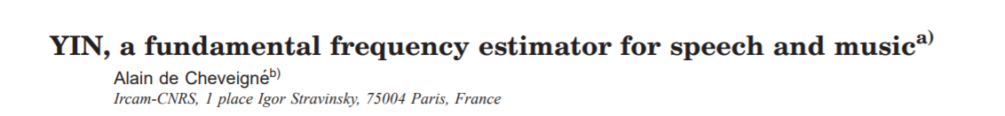
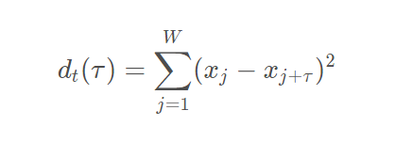
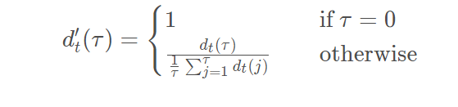
Yin(has realized)
ACF->difference function
Normalize(exclude small period)
Threshold,windows

Slide 4
Find the note of audio(mainly the length of note)
1.Use Yin find the f0 sequence of the audio
2.Convert f0 to pitch
3.Find the onset of each note
4.Statistical methods were used to find the most appropriate pitch between onset[i] and onset[i +1] as the pitch of the whole interval.
5. The last 50% (or 30%, as you can adjust) of each interval is mute.

Slide 5
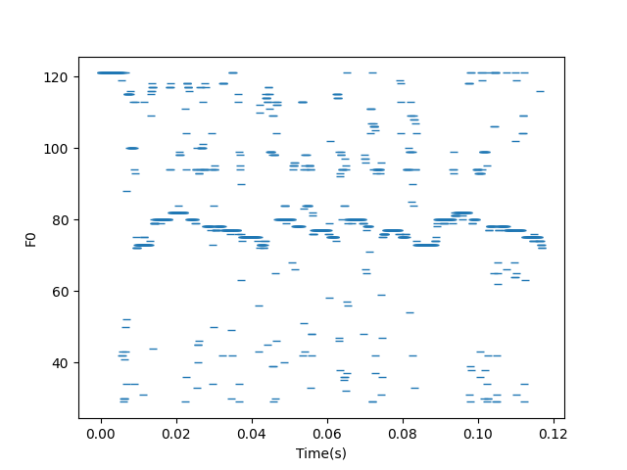
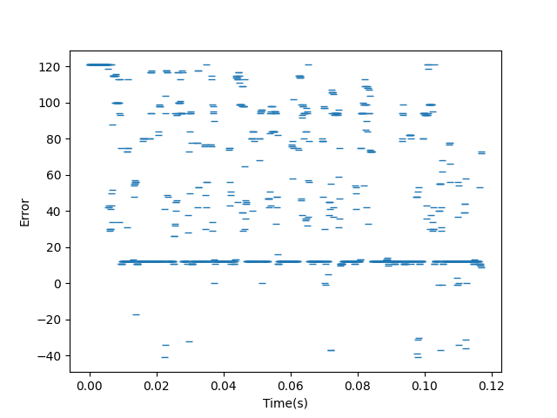
Before adding distribution(just yin algorithm)

Slide 6
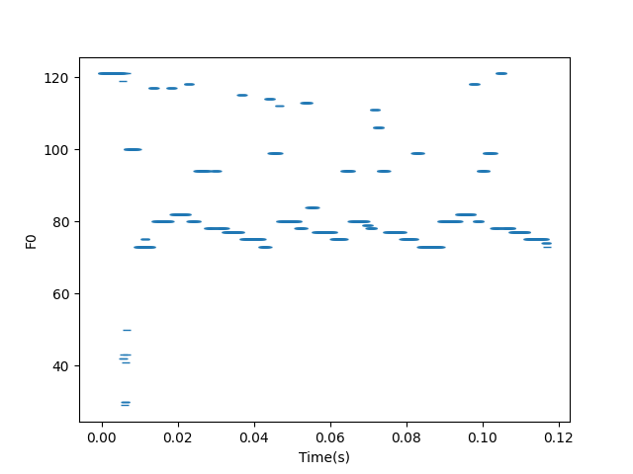
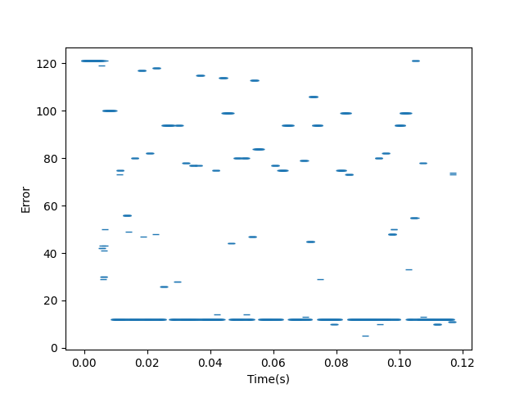
After adding statistical distribution(rounding)

Slide 7
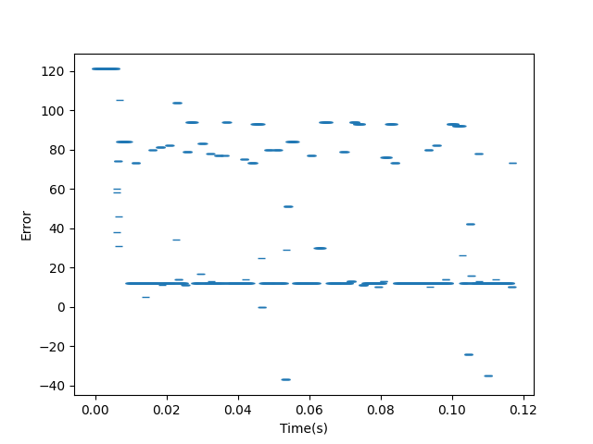
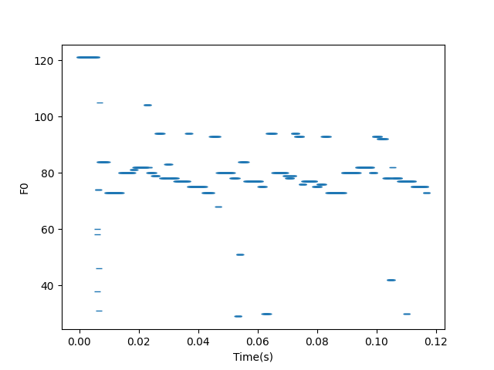
After adding bandpass filter
Use bisection to get a good threshold

Slide 8
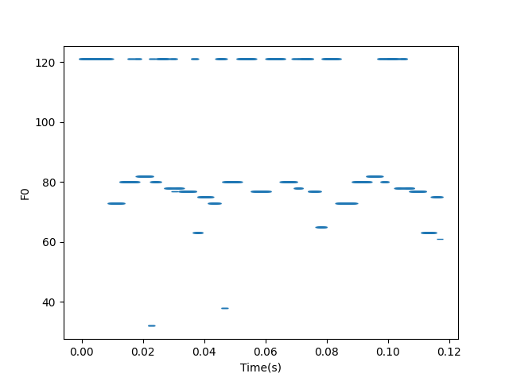
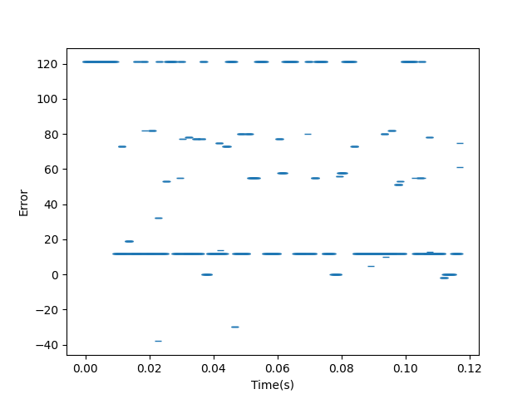
After adding rest filter(clear note achieve)
8 interval: Octave singer, the reason of error: Vocals cannot be perfectly aligned with MIDI

Slide 9
Evaluate note detection
The error calculation is not based on pitch but based on the number of points that is not zero in error array.
The reason that not to calculate the pitch difference is: error evaluation based on pitch will have problem.
The result(after processing 50 wave files and corresponding 50 midi files):
Average error points for each wave file: 171.7
Hop size: 1024
Duration for each file: 40seconds
Sample rate: 44100 Hz
Total points for each file: 1723
Error: 171.7/1723=9.965%

Slide 10
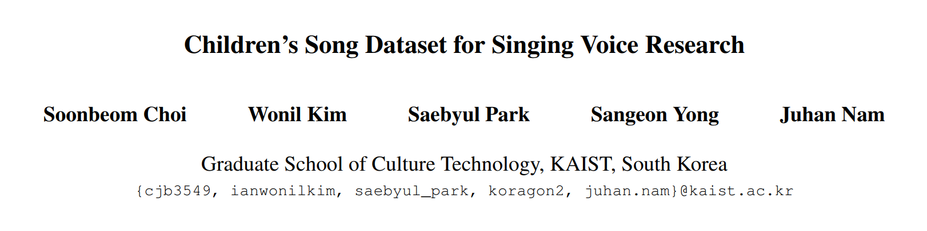
Next: Find Dataset
Dataset: CSD

Slide 11
Next step: Searching algorithm
Change to relative pitch
Calculate the distance

Slide 12
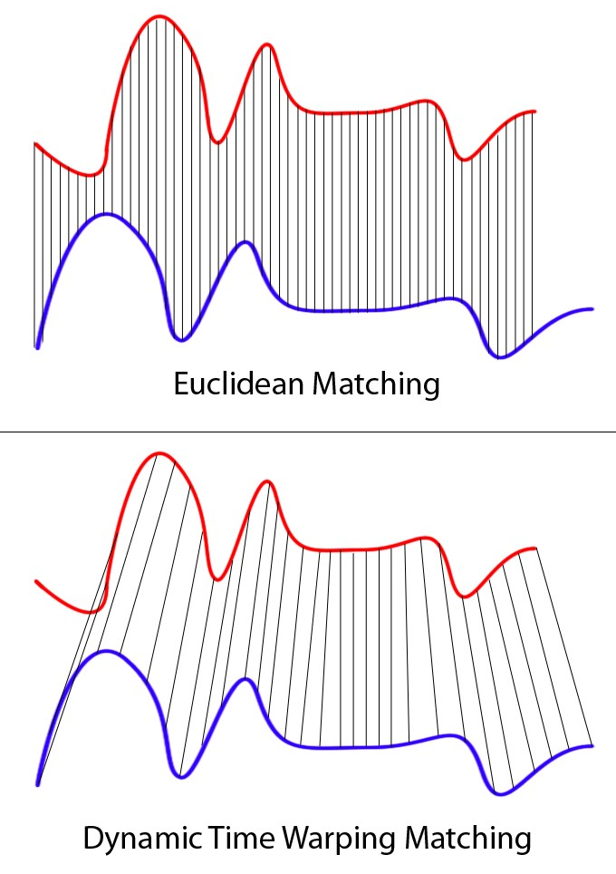
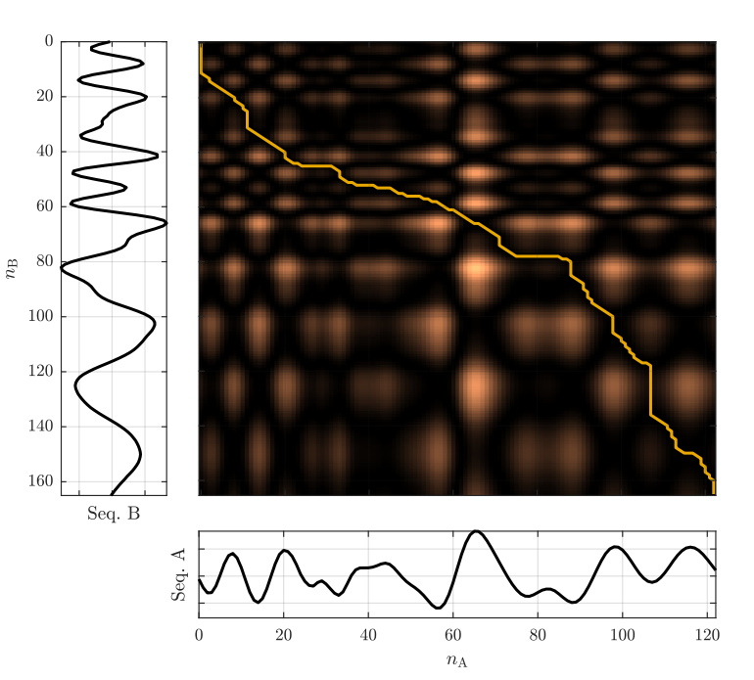
DTW (Dynamic Time Wraping)

Slide 13
Edit Distance
How many operations do it cost from string1 to string2?
Three types of operation:
1.Insertion
2.Deletion
3.Substitution

Slide 14


Accuracy for midi testing
Accuracy:100%
50 midi files searching in 50 midi files
Time length=40seconds
Method: DTW
For Edit distance, the accuracy is also 100%
So the accuracy problems in searching is not caused by similar contour in songs.

Slide 15
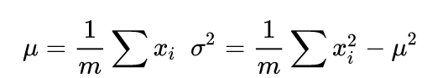
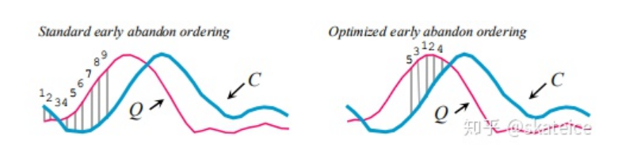
Way to do subsequence search: Optimizing DTW
Complexity of DTW is O(mn), m and n is the length of the input sequence and ground truth sequence.
Optimizing:
Early abandoning Z-Normalization
Early abandoning: When the score is better than best-so-far, stop calculation to save time.
Low-Bounding

Slide 16
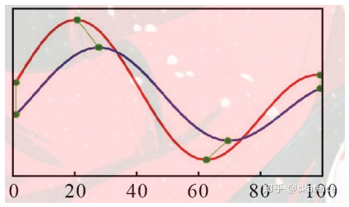
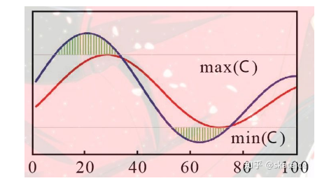
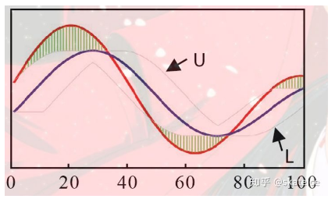
For low-Bounding
LB_Kim
LB_Yi
LB_Keogh

Slide 17
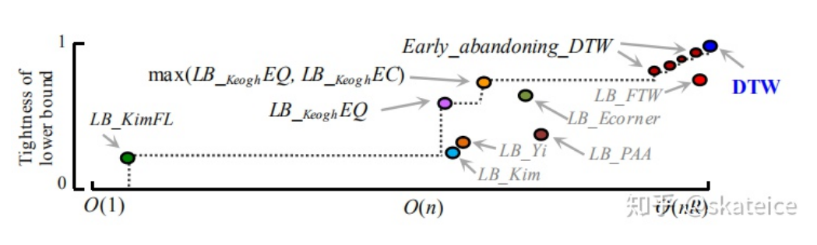
Complexity

Slide 18
Thank you!

